Slide 1

AMACSS Study Group
Object, ADTs, and implementation

Slide 2
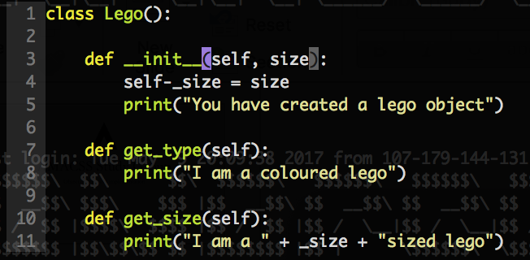
Review of Objects
Classes are the types of objects
Allow us to define our own ”types”
Give them methods
Attach attributes to them
Allow us to customize our program beyond what’s built in
Think of them like building our own toys with Lego’s
Notes:
Using isinstance() to check if something is of a certain type
Classes are created using camelCase

Slide 3
Review of Objects
Private vs Public Variables
Public variables are named regularly, anyone can access them in any way they want
Private variables denoted by _var_name
Part of encapsulation is that users cant access these
create methods that allow them to change or access this var without ever calling it
i.e getters and setters
Accessing the variable requires knowledge of the implementation, and that’s a no no
Notes:
Using isinstance() to check if something is of a certain type
Classes are created using camelCase

Slide 4
Examples of Objects
Queue
First In First Out (FIFO)
Can be represented using a list
Usually has a get, put, peek, is_empty methods
See implementation
Stack
Last in First Out (LIFO)
Can also be represented using a list
Similar methods to Queue
See implementation

Slide 5
More Examples of Objects
Stueue
First insertion/removal operation acts like a Stack
Every operation after that switches between Queue and Stack
Similar methods as Stack and Queue
Try:
Implementation, OR
Turning ”CRABAPPLE” into “APPLECARB” using a Stueue
Alternating Queue
Acts as a Queue, but alternates between left and right after every insertion/removal
Same methods as a Queue
See implementation
Notes:
Explain: put(), move(), get()

Slide 6
Review of ADTs
Objects that can be used regardless of implementation
User doesn’t need to know the inner workings, only the methods
Black box design
User has no idea what’s going on under the hood
INPUT
PROGRAM
OUTPUT
Notes:
Explain: put(), move(), get()

Slide 7
Let’s create an ADT!

